Slide 1
Linear Algebra & Medical Imaging
Automating Brain Tumor Detection
Wesley Chen and Brandon Sim

Slide 2
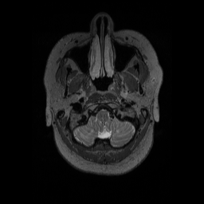
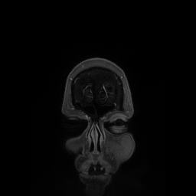
Introduction of MRI
Wide range of use across all organs to detect bleeding, tumors, etc
10,000 MRI Machines in the United States
Many 2D slices to form the 3D model

Slide 3
Two Independent Approaches
Symmetry Analysis
Use edge analysis to provide closed regions
Test symmetry to confirm abnormality
Watershed Segmentation
Treat grayscale image as toplogy
Identify foreground vs. background

Slide 4
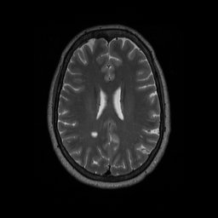
The Original MRI Image

Slide 5
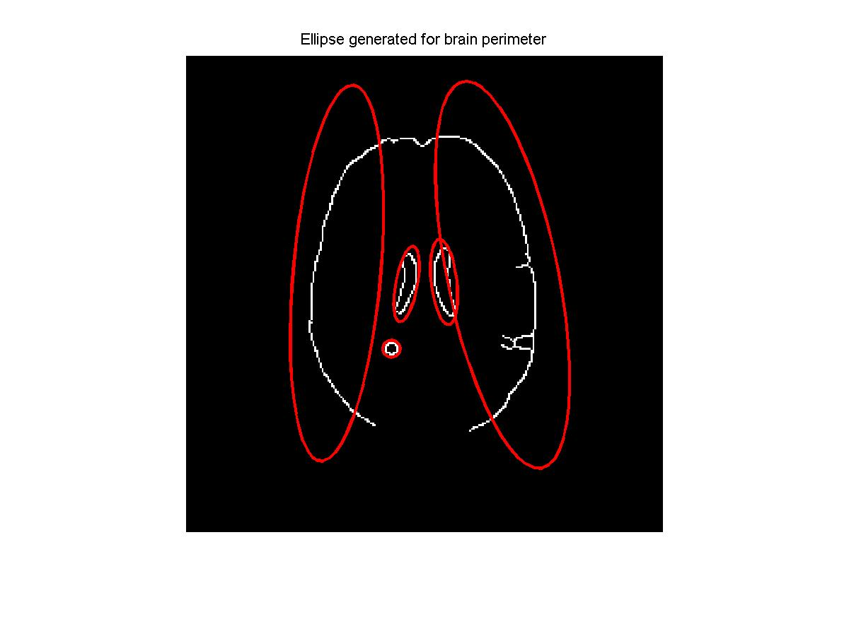

Symmetry Analysis: Canny Algorithm

Slide 6
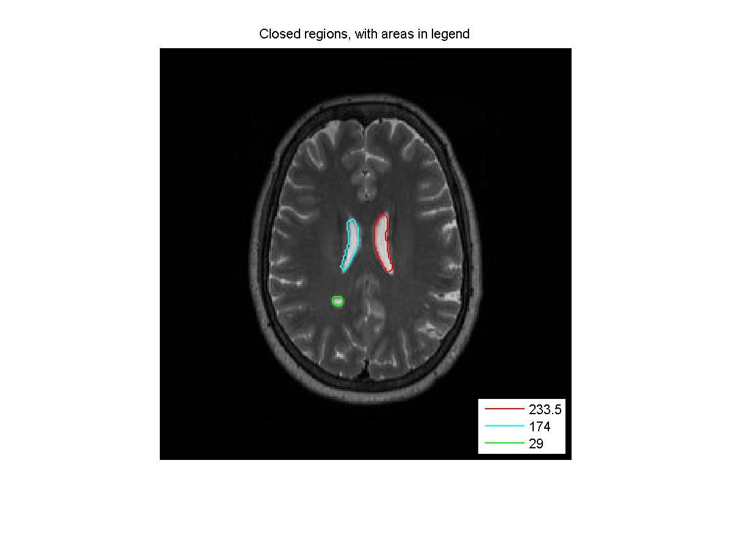
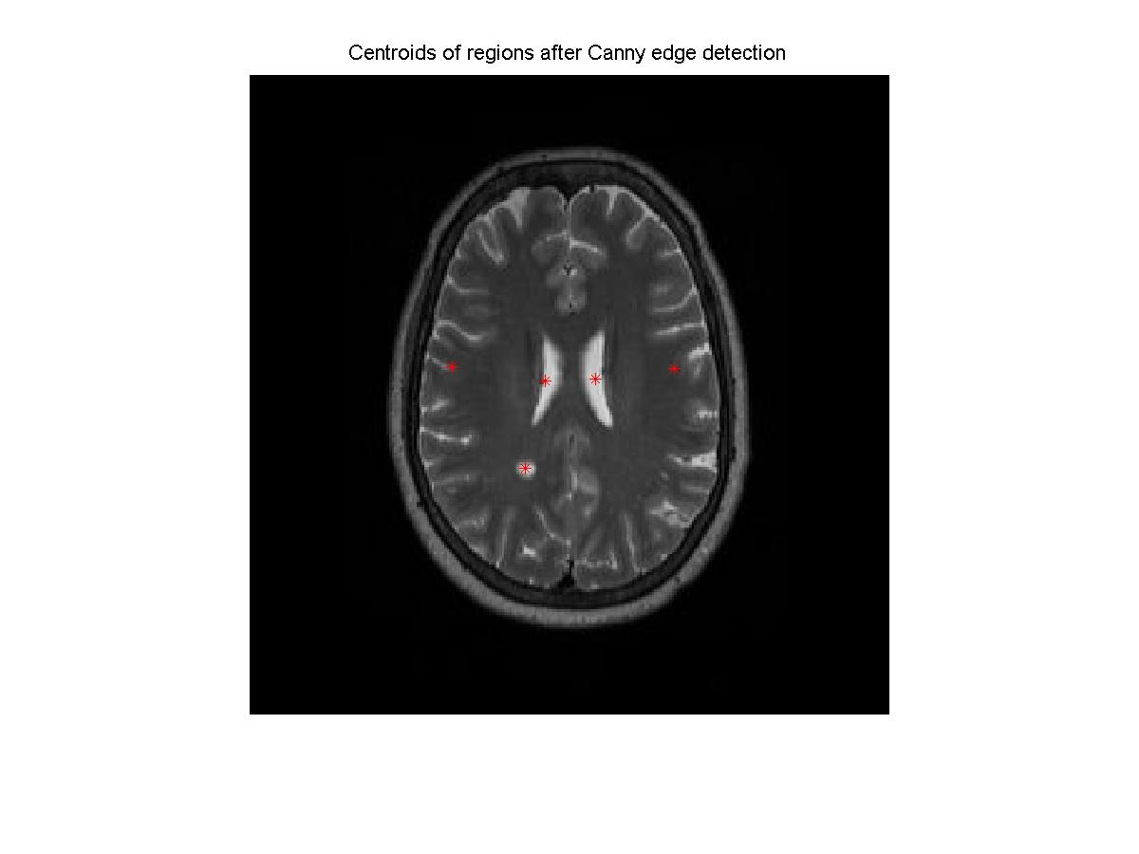
Symmetry Analysis: Closed Figures

Slide 7
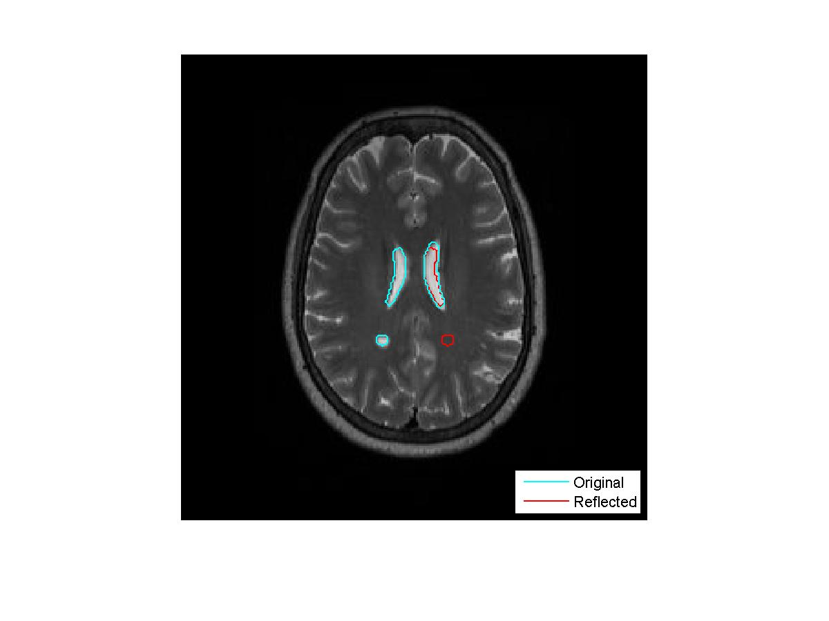
Symmetry Analysis: Reflection

Slide 8
Symmetry Detection: Multiple Slices
Results!

Slide 9

MRI Original and Lily Pad Landscape

Slide 10
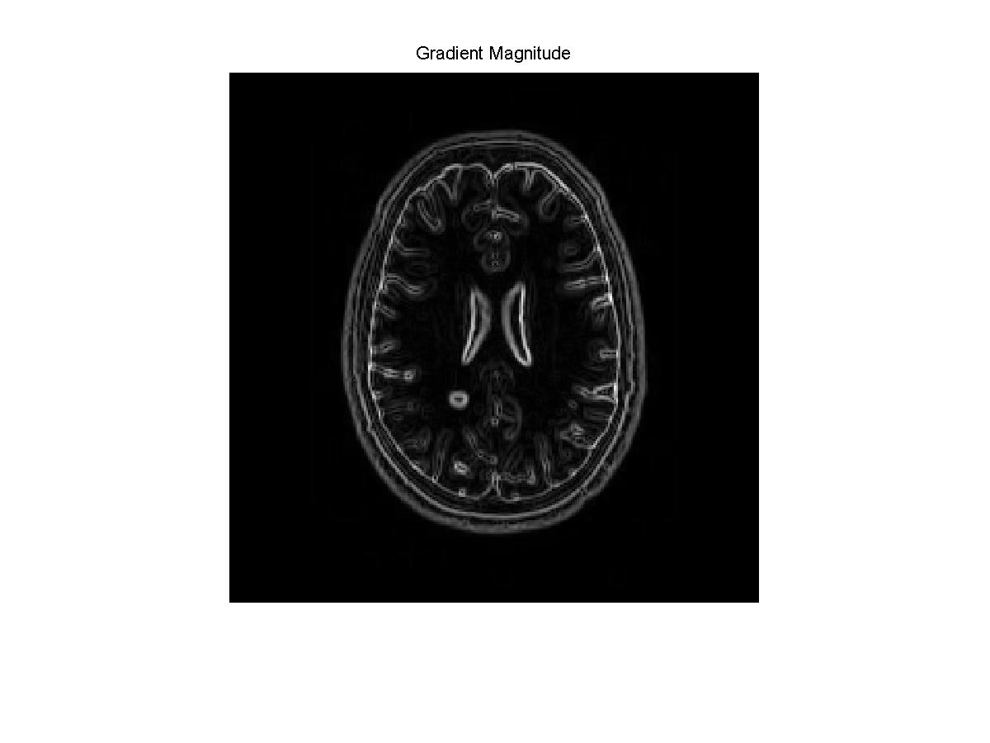
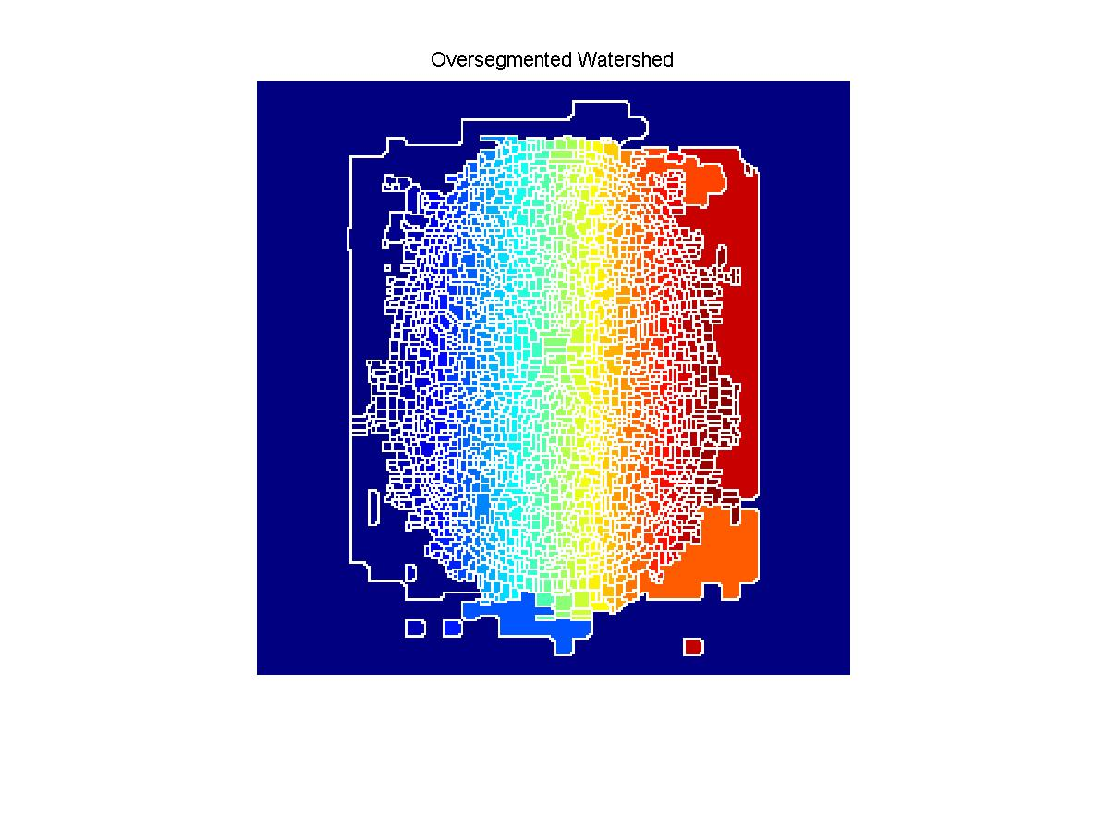
Watershed: Pure Gradient MRI

Slide 11
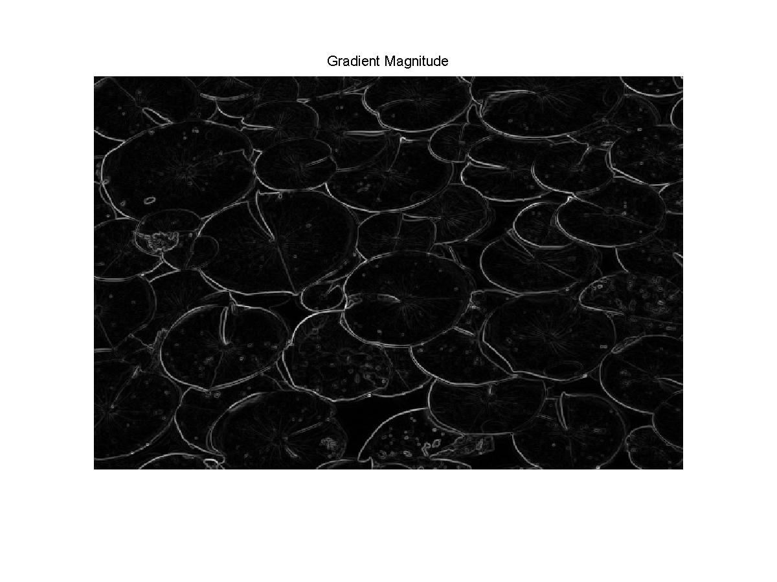
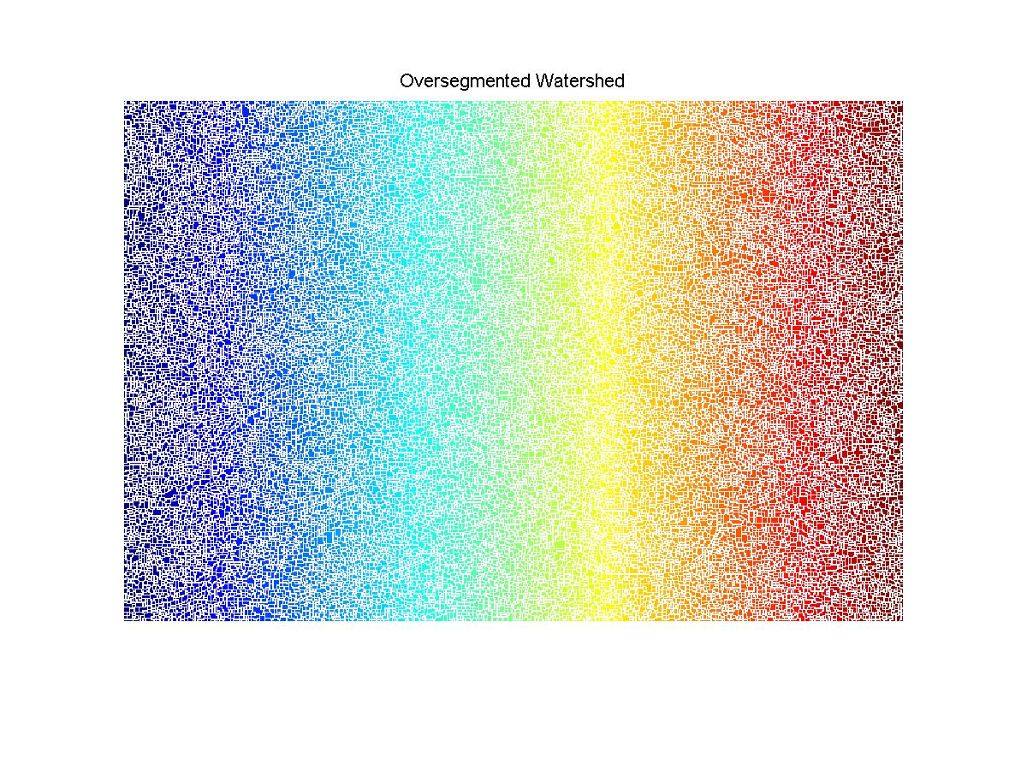
Watershed: Pure Gradient Lily Pad

Slide 12

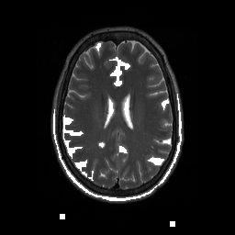
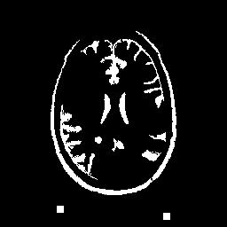
Watershed: Marking Foreground MRI

Slide 13



Watershed: Marking Foreground Lily

Slide 14




Watershed: Finding Background

Slide 15
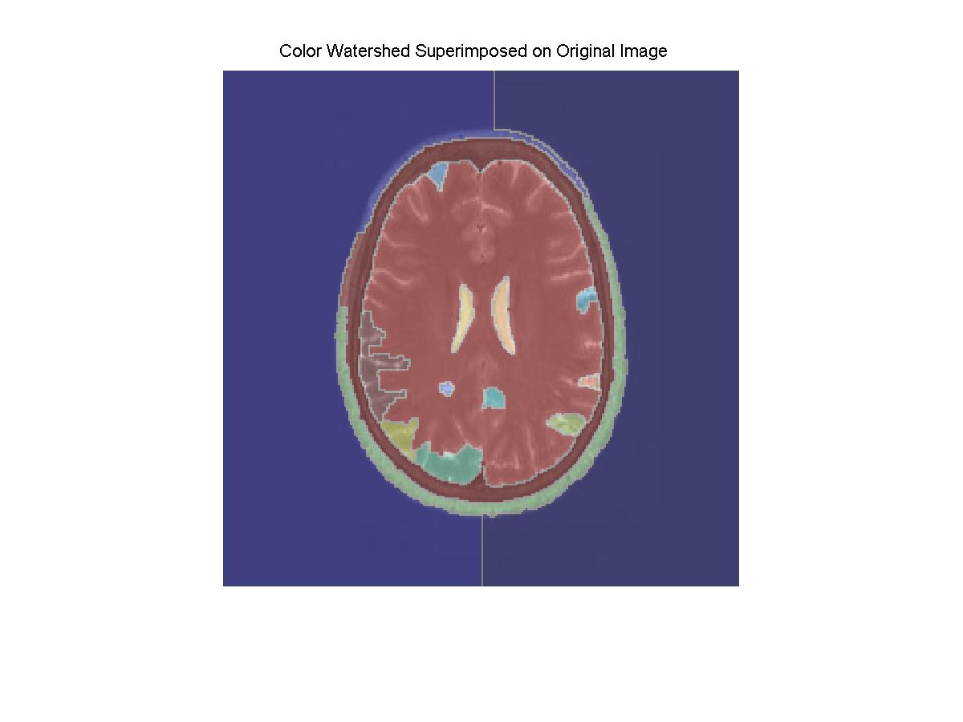
Watershed: Colored Visualization MRI

Slide 16

Watershed: Colored Visualization Lily

Slide 17
Discussion
Help pre-filter data for doctors
False Positives
Give suggestions of mostly likely candidates
Symmetry Analysis
Simple and clean
May miss complex tumors
Watershed
More complex and not as clean for smaller tumors
Will detail all areas, less false negative

Slide 18
Future Work
Integrate the two separate approaches
Use different angles of the MRI data

